Slide 2
How has the opioid epidemic affected people?
How has the opioid epidemic impacted emergency room related costs?
How has the opioid epidemic involved families as part of the solution?
How has the opioid epidemic involved education as part of the solution?
Notes:
As an engage activity, students will share what they know about the US opioid epidemic and its impact on different parts of a community.
Divide students into groups of 3–4. Display 4 large sheets of chart paper along one side of the room. Each sheet should have one of the following prompts:
o How has the opioid epidemic affected people?
o How has the opioid epidemic impacted emergency room related costs?
o How has the opioid epidemic involved families as part of the solution?
o How has the opioid epidemic involved education as part of the solution?
Create another set of 4 large sheets with the same prompts on the other side of the room.
Distribute a different color marker to each group. Start off each group at one sheet of paper and provide 2-3 minutes for students to respond to the prompt. Repeat three more times as teams rotate through each prompt and add their ideas. Students should be guided to be additive and not repetitive. When time is up, invite students to go back to their original papers and direct groups to summarize the ideas.
Ask each group to report out the information from the conversation and invite students to draw conclusions about consistent or conflicting information, predictions, and questions.

Slide 3
Notes:
Distribute the December, 2016 feature story from the Washington Post, “Orphaned by America’s Opioid Epidemic” http://www.washingtonpost.com/sf/national/2016/12/17/orphaned-by-americas-opioid-epidemic/
Guide students to use a Close Reading Strategy as they obtain information by reading the article. Students should respond to the following questions on a blank sheet of paper as they read:
o What claims does the author make?
o What evidence does the author use to support those claims?
o How is this document supposed to make me feel?
o What words or phrases does the author use to convince me that he/she is right?
o What information does the author leave out?
Ask students to return to their groups from slide one and share their responses. Guide students to revisit the prompt they summarized in slide one and make any changes based on information from the article. Then, ask each group to evaluate what they think is the most significant impact.

Slide 4
Do you think our community is impacted by the opioid epidemic?
What evidence supports your response?
Notes:
Ask students:
Do you think our community is impacted by the opioid epidemic? What evidence supports your response? It is anticipated students will share they have seen news reports, discussed the topic in other classes, heard information on the radio, or noticed reports on social media. Students may say their community is not impacted because they have not noticed any reports.
Guide students to brainstorm five resources that could help them find out.
Anticipated responses include news articles, infographics, interviews, outreach and awareness flyers, news videos, and guest speakers.

Slide 5
Describes how you plan to conduct your research.
Organizes your ideas.
Outlines your research to better understand your results.
Notes:
Divide students into research teams of 2-3 students. Distribute the Research Plan Student Handout. Explain to students that a research plan describes how you plan to conduct your research. It helps you prepare and organize your ideas to better understand your results. Students will use the graphic organizer to begin planning out how they will research if/how the opioid epidemic has impacted their community.
Use the following guiding questions to support students with completing their research plan.
o Does our community have an opioid addiction problem?
o How widespread is it?
o Who does it affect?
o How has the opioid epidemic affected people?
o How has the opioid epidemic impacted emergency room related costs?
o How has the opioid epidemic involved families as part of the solution?
o How has the opioid epidemic involved education as part of the solution?
o What ways could we begin, at our school, at home, or in our community, to work on drug education or prevention to stop this problem from spreading?

Slide 6
Notes:
Use the slide to display common domains encountered during internet searches. Invite students to rank them from most credible to least credible and justify their ranking. This will help students identify credible sources when they start their research.
o .org: An advocacy web site, such as a not-for-profit organization.
o .com: A business or commercial site.
o .net: A site from a network organization or an Internet service provider.;
o .edu: A site affiliated with a higher education institution
o .gov: A federal government site.
Emphasize that .org, .gov, and .edu are typically more credible sites than the others.
Distribute Tips for Finding Credible Online Resources Student Handout to support students with evaluating websites. Invite students to review the resource and revisit their Research Plan Student Handout to add any additional ideas.

Slide 7
Notes:
Explain to students that they will review a video resource to help them kick-start their research with some background information.
Display the TED Talk, “Insight into the Teenage Brain” (9 mins. 38 secs.). Invite students to think about how they make decisions. While watching, have students consider what issues in Dr. Galvan’s research findings sounds familiar to them, and what doesn’t. https://www.youtube.com/watch?v=LWUkW4s3XxY
Teacher Note: Consider providing guiding questions (examples below) for students to respond to as they view the video.
How does the teenage brain make decisions?
Brains continue to mature and develop throughout adolescence and well into early adulthood. The brain is more likely to react strongly to positive feelings and make riskier decisions.
What is the last brain region to develop?
Prefrontal cortex.
What are the functions of the prefrontal cortex?
Part of your brain that helps you think about consequences or potential consequences and regulates behaviors and emotions.
4. What is the striatum and what is its function?
The striatum is a region of the brain and key component of the reward system.
5. What does dopamine do, and why is it more active in teens?
When you receive something you find rewarding, your striatum releases dopamine. Dopamine regulates emotional responses and enables us to see rewards and take action.
6. When someone gets an fMRI scan, what are researchers seeing?
Researchers are seeing a snapshot of the brain in motion. While you are experiencing something you like, it can capture how your brain is responding.
7. Why do researchers think that teen brains are more activated when they get a reward (like sugar water, in the video)?
Dopamine is more active in teenage brains as evidenced by the deeper layers of the brain being activated.
8. During adolescence, teens seek more rewards. How do you think that might relate to using or misusing opioids?
Opioids target the brain’s reward system, flooding it with dopamine.
9. How might the focus on rewards translate into pursuing healthy activities? Think about being open to new challenges, meeting new people, creative activities and learning.
Answers will vary.

Slide 8
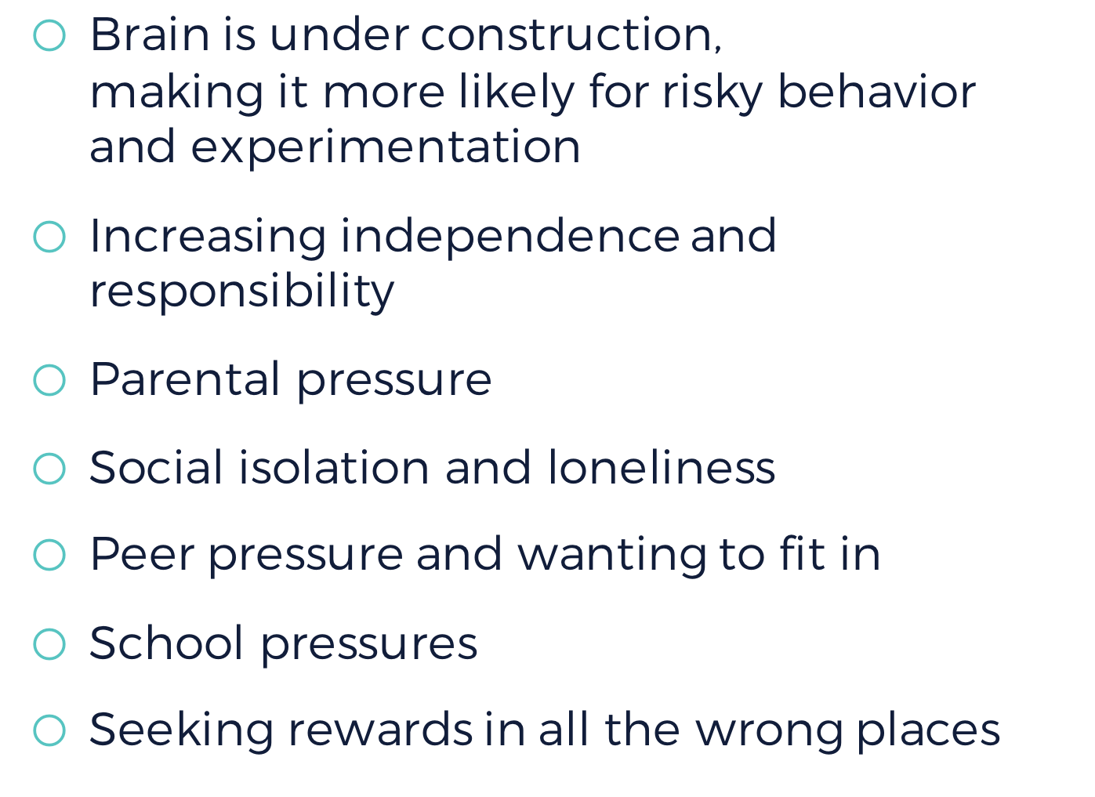
Notes:
Lead a discussion with the class to help them list key takeaways from the TED Talk on what they’ve learned about why teens might be more vulnerable to heroin and prescription opioids than adults.
Invite teens to share ways these changes show up for them:
o Brain is under construction, making it more likely for risky behavior and experimentation
o Increasing independence and responsibility
o Parental pressure
o Social isolation and loneliness
o Peer pressure and wanting to fit in
o School pressures
o Seeking rewards in all the wrong places

Slide 9
Notes:
Interactive maps – for an excellent CDC interactive map depicting the opioid epidemic geographically: https://www.statnews.com/2017/04/25/opioid-deaths-map/
Instructor Notes:
Explain to students that it is said that pictures speak louder than words. Guide students to brainstorm: What are some of the ways reporters use to illustrate the facts to give readers a visual look at what is essential? Instruct students to review newspapers or online news sites to find images that support factual information.
Display additional ideas using the slide. Clarify with students that their evidence should also include visual elements they constructed or cited. Students can illustrate facts in both traditional ways (graphs, tables, charts) and in more pictorial ways (infographics, wordless illustrations)
o Charts and tables
o Photos and/or videos
o Infographics
o Interactive maps

Slide 10
Notes:
Invite students to examine local news stories and other resources they identified in their research plan to investigate how widespread the use of opioids is, and get a context for the scope of the problem. Knowing now that teens are at a greater risk, students should target their research towards a teen audience. Provide time for students to conduct their research and record their findings.

Slide 11
Notes:
Ask each team to share its research, headline, and any graphics, maps or photos with the class. Ask one student from another team to serve as a recorder who writes the key ideas on the board. Ask each team to present, with students from other teams acting as reporters.

Slide 12
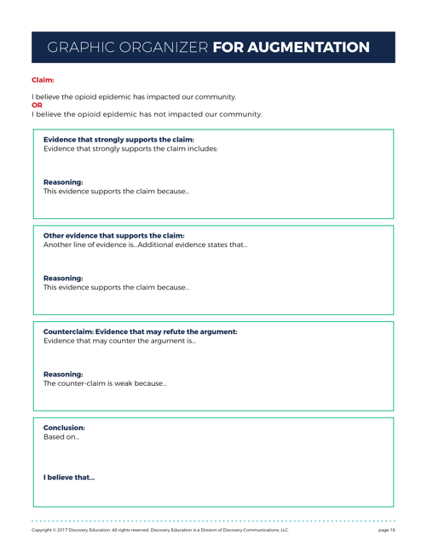
Notes:
Lead a discussion to review the main ideas. Using the class evidence, determine if their community is impacted by the opioid epidemic, or if the opioid epidemic has not impacted their community.
Designate one side of the room as "not affected at all" and the other as "significantly affected." Instruct students to create a human barometer to visualize their conclusion by placing themselves on either side of the room, or somewhere in-between, depending on their evidence based decision.
Guide students to complete Graphic Organizer for Argumentation from Evidence Student Handout to summarize their claim using evidence from their own research and their peers.

Slide 13
Notes:
NIDA’s 2016 Monitoring the Future report https://www.drugabuse.gov/related-topics/trends-statistics/infographics/monitoring-future-2016-survey-results
Once students have summarized their findings, it’s time to share that with the school community. Students have spent time creating materials outlining the scope of the problem and what they have learned. Guide students to identify one or two key, overarching messages they would like other students to know about the opioid epidemic.

Slide 14
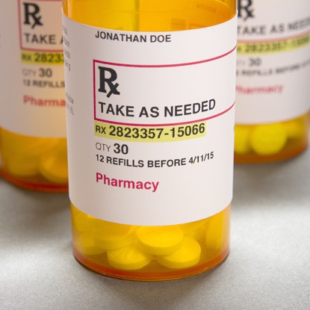
Notes:
Invite students to think about the audiences they want to reach with their overarching messages, who they are, what they care about, and the best ways to reach them.
o Who are the student audience(s) you want to reach?
o What are the messages students would like for the community to know?
o Is word of mouth the best way to engage families and others?
o Could students organize a presentation to the PTA? How would they promote it?
o Which social media tools will reach outside audiences and how do you build greater awareness?
Students may choose to create a digital campaign, flyers, video PSA, podcast, or blog with posts of their research and interviews to share within the school and community, so that other students can benefit from their research.

Slide 15
Notes:
Distribute the Levels of Reflection Student Handout for students to summarize and reflect on the impact of the US opioid epidemic. Ask students to select one question from each level to respond to as part of their reflection. The mirror invites students to consider the individual impact of researching the opioid epidemic. The microscope guides students to consider how this research helped students learn more about their community. The binoculars ask students to reflect on larger social issues and their own personal development.

